Slide 1

The IPMC

Slide 2
Work Shadowing
3 days watching two shifts of the IPMC, 9am – 5pm
Shadowed Mike McTernan and Paul Hodds
Also talked to Greg Bird about SMARTs
Main questions:
What is the basic structure of the 21C network?
How is the 21C network monitored, maintained and repaired?
Notes:
What did you do?
Why did you do this? To learn about the structure of a network. To learn how a network is maintained. To get some opinions from the IPMC team, since they, or people like them, are our customers.

Slide 3
The 21C Network
Access
Harlequin
(e.g Orange, Virgin)
Metro
VLAN to ISP
BT Retail
Colossus
Core
Plusnet
BEA
BRAS
RADIUS
MSAN
Notes:
This is, very roughly speaking, the structure of the 21C network, and is generally the model the IPMC use when they talk about the network.
There are obviously many devices missing from this diagram, but this is the general structure.

Slide 4
The 21C Network
Access
Metro
Core devices are fully meshed.
(few problems or changes)
Metro and Access devices usually have redundancy.
Lots of changes made, lots of devices so lots that can go wrong.
Core
Notes:
Problems generally occur on the metro and access areas, because they change the most, and are not fully meshed.
An example of where there is no redundancy is on certain BEAs: the customer has requested more bandwidth, so rather than installing new kit they are simply running traffic over both their primary and failover boxes.

Slide 5
What the Ops Team Does
Monitors the devices on the 21C network.
Fixes problems picked up through monitoring, or through customer complaints.
‘Customers’ in this case are the ISPs – BT Retail, Orange, Plusnet etc.
Often they simply have to prove traffic loss isn’t caused by a fault on the 21C network.

Slide 6
Team Structure
One team is made up of:
two Alarms Operators
six Network Engineers
One team supervises the 21C network, one team supervises 20C
Also RSN and Wifi teams

Slide 7
Process – monitoring
Alarm raised on SMARTs or session drops are recorded by Rabit
Alarms operator verifies fault and attempts any quick fix possible
If problem lasts longer than 10mins they create an incident on IRAMs, and create a ticket on AutoFix
Other warnings:
a complaint is raised by a customer
a request for confirmation is requested by a customer

Slide 8

Process - fixing
IPMC Engineer picks up the Autofix ticket
Uses PACs to find out information about the devices involved
Logs onto the box
Interrogates the box and neighbouring boxes
Is this a hardware fault?
What is the single point of failure?
Is there any unusual behaviour?
Notes:
Similar questions and processes involved as when fixing a software bug.
Except the software is distributed across many different, often independent boxes, and is there are several processes running on each box.

Slide 9

Tools
PACS
Autofix
ALS
SMARTS
ESID
SAM

Slide 10

SMARTS
Often the first sign something is wrong
Must be verified before being acted upon
Polls devices every four minutes
(so lots of data kept about the system)
Traffic
Temperature
CPU usage
Memory
Fans
PSUs
Uses PACS to find devices
Notes:
Omnibus is the equivalent on the internal networks.

Slide 11
SMARTS
Also monitors groups of devices that make up a route or service
Does root-cause analysis when these services go down
Auto-tickets faults straight into AutoFix without bothering the alarms operators
Does this 90% of the time for Access MSANs

Slide 12

RABIT
Notifies the Alarms Operators of large amounts of session drops.
Sporadic drops might just be people rebooting their home hub.
Large outages indicate a fault on the network.

Slide 13

PACS
Inventory system
Acts as a map of the network
Physical layer – no VLANs
Really useful, when it is accurate
IPMC only have read access
IPMC has no way of notifying PACs that they have had to modify the network
This leads to problems as PACs will provision devices that are already in use
IPMC team work in shifts, meaning it takes longer for the Design Team to catch up
Slow to change
Notes:
There are many systems that make up the alternatives to this on the internal network, but I think the main ones are RatSpit PI and IONICS

Slide 14

NH21
Just not used
Clunky
Slow
Updates measured in years
A better system?
responsive
shows changes on the network
e.g differences between now and the same time last week

Slide 15
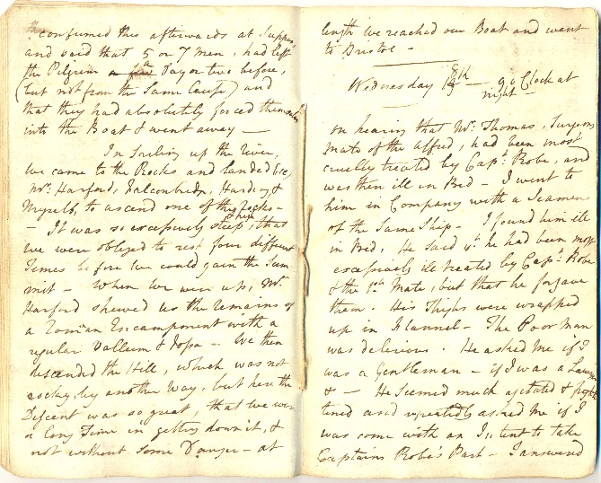
ALS
Used to keep a journal of all operations carried out on the network
Allows multiple people to work on the same ticket at different times
Links together all the other numbers and IDs the team has to remember
Records observations and overall progress
Notes:
WE NEED TO LOOK AT THIS
They use it, a lot.
It was built for them by someone who worked with them.
It contains a lot of information about the network.

Slide 16
Example Problem
Traffic loss reported by BT Retail.
Problem turns out to be a link has been ‘costed’ wrong.
Links between different devices can be artificially ‘costed’ to make them prefer a route over another
If someone fat-fingers the numbers, a link can end up becoming over-desirable and the over-loaded router at the end of it starts dropping packets
This is particularly tricky as the router may end up being unreachable even to management traffic

Slide 17
Example Solution
An engineer is sent out to manually log into the router and reconfigure it
This is quite labour-intensive to solve, as the IPMC engineer has to be on the phone to the engineer the entire time to tell him what commands are needed
Notes:
How could we solve this?
Possibly by putting config changes into version control.
This is the sort of thing that could be caught and warned against by a config validator.

Slide 18
Conclusions
SMARTS is not trusted (regarded as about 70% inaccurate)
NH21 is not used
PACs is generally useful as a map
Communication and logging tools are useful (ALS, Autofix, IRAMs)
Utility and speed are key
The IPMC team are perfectly happy to have you follow them around for a while
(probably best to ask them first though)
Notes:
The operations people are very welcoming and very knowledgeable about the network.
They understood the value of somebody from software coming to them to learn about networks.

Slide 19
Conclusions
Data analysis?
The IPMC only really examine the network in the short-term
e.g SMARTS (or Omnibus on the internal network)
Needs to be more accurate
Needs a way to report inaccuracies
Could predict or catch more subtle network problems
Examine behaviour over longer periods of time

